Slide 1


1
MERGE, ENSEMBLE, AND COOPERATE! A SURVEY ON COLLABORATIVE STRATEGIES IN THE ERA OF LARGE LANGUAGE MODELS
JINLIANG LU, ZILIANG PANG, MIN XIAO1, YAOCHEN ZHU3 , RUI XIA3, JIAJUN ZHANG
INSTITUTE OF AUTOMATION, CHINESE ACADEMY OF SCIENCES, BEIJING, CHINA
SCHOOL OF ARTIFICIAL INTELLIGENCE, UNIVERSITY OF CHINESE ACADEMY OF SCIENCES, BEIJING, CHINA
NANJING UNIVERSITY OF SCIENCE AND TECHNOLOGY, NANJING, CHINA
WUHAN AI RESEARCH, WUHAN, CHINA
LINK - HTTPS://ARXIV.ORG/PDF/2407.06089V1

Slide 2
2
OVERVIEW
Introduction
Result
Methodology
Conclusion
Techniques

Slide 3
3
INTRODUCTION
WHAT IS THE IDEA?
The paper investigates the collaborative strategies that can be employed among large language models (LLMs) to enhance their performance.
It introduces concepts such as merging, ensembling, and cooperation, which allow models to leverage each other's strengths.
The idea is to create a more robust and versatile AI system capable of handling complex natural language processing tasks.
Collaboration Types:
Merging: Combining outputs from different models to create a single, more accurate response.
Ensembling: Using multiple models to generate predictions and aggregating these predictions to improve overall accuracy.
Cooperation: Models working together, sharing knowledge and insights to solve complex problems.

Slide 4
4
INTRODUCTION
WHY IS IT IMPORTANT?
As LLMs are increasingly integrated into various applications (e.g., chatbots, content generation, translation), understanding how to optimize their performance is critical.
Collaborative strategies can lead to significant improvements in accuracy, efficiency, and adaptability of AI systems.
This research is essential for advancing the field of AI, ensuring that models can work together effectively to solve real-world problems.

Slide 5
5
METHODOLOGY
DATASETS
The paper discusses various datasets utilized for training and evaluating collaborative models, emphasizing the importance of diversity in data.
Datasets such as SQuAD, GLUE, and others are highlighted for their relevance in natural language understanding tasks.
The choice of dataset impacts the performance of collaborative models, making it crucial to select representative and comprehensive datasets.

Slide 6
6
METHODOLOGY
MODEL
The paper reviews different model architectures suitable for collaborative strategies, including transformer-based models like BERT, GPT, and T5.
It discusses the strengths and weaknesses of each model type in the context of collaboration.
The paper emphasizes the importance of selecting models that complement each other’s capabilities to maximize performance.

Slide 7
7
METHODOLOGY
METRIC
Evaluation metrics are critical for assessing the performance of collaborative models.
The paper discusses metrics such as accuracy, F1 score, and BERTScore, which provide insights into the quality of generated outputs.
It highlights the need for robust evaluation frameworks that can capture the nuances of collaborative performance.

Slide 8
8
TECHNIQUES FOR COLLABORATION
1. Merging :
Combining outputs from different models to create a single, more accurate response.
i)Merging for Relatively Optimal Solution (M-ROS)
Aims to improve model performance by merging parameters from various models that converge near local optima.
Key Methods:Simple Average and Weighted Average
ii)Merging for Enhancing Multi-Task Capability (M-MTC)
Create a unified model that can effectively handle multiple tasks by merging models trained on different datasets.
Key Techniques:
Weighted Average, Task Vector, Pruning Redundant Parameters, Parameter conflict Training.
Toolkits: New open-source toolkits, like Arcee’s MergeKit, facilitate the integration of various merging methods for LLMs.

Slide 9
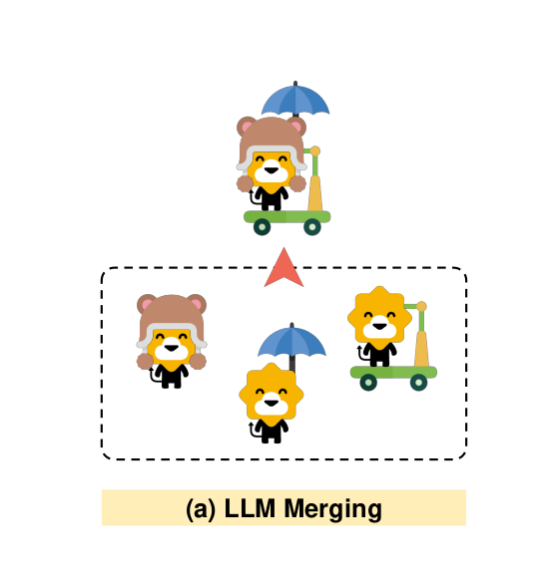
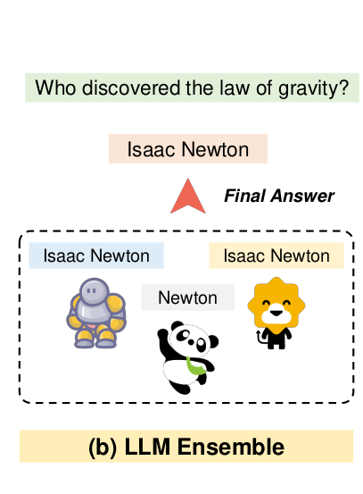
9

Slide 10
10
TECHNIQUES FOR COLLABORATION
2. Ensemble :
Using multiple models to generate predictions and aggregating these predictions to improve overall accuracy.
Ensemble Approaches :
1.Before Inference:
Select the best LLM for specific inputs using external routers before predictions.
2.During Inference:
Combine outputs at each decoding step to mitigate errors and hallucinations.
3.After Inference:
Select the best response from multiple generated outputs.
Using unsupervised metrics (e.g., BERTScore) to select the best candidate from generated outputs.

Slide 11
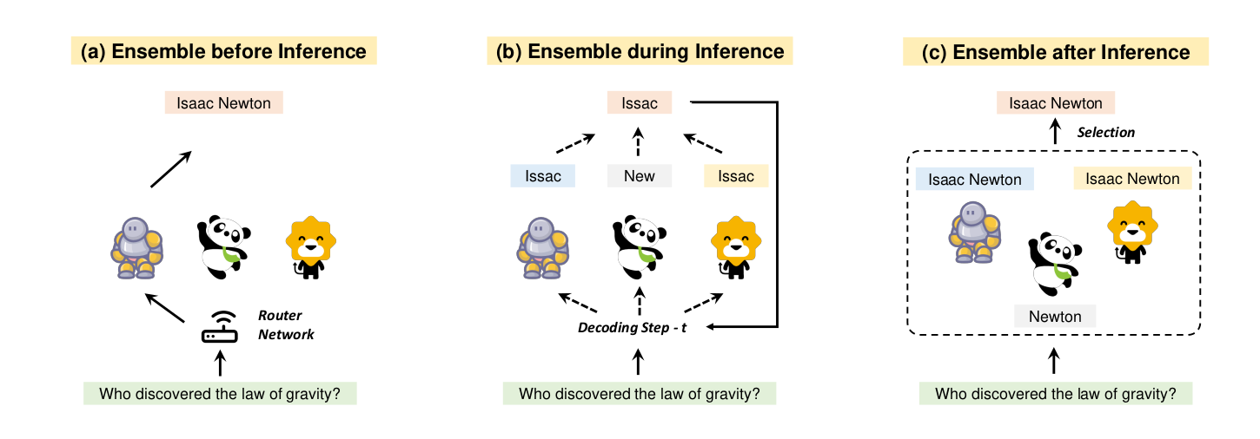
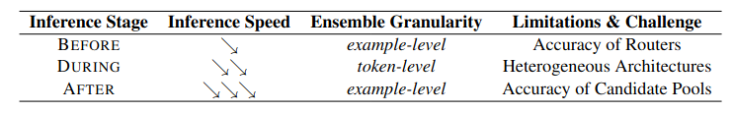
11

Slide 12
12
TECHNIQUES FOR COLLABORATION
3.Cooperative Learning: :
Cooperation among LLMs extends beyond merging and ensemble methods, focusing on collaborative strategies to solve various problems and enhance performance.
Key Cooperation Strategies:
1.Efficient Computation:
Input Compression: Smaller LLMs compress inputs to reduce computational costs and memory usage, improving inference efficiency.
Methods:
Prompt Pruning: Removes unimportant tokens to shorten prompts.
Prompt Summarization: Condenses prompts while retaining semantic meaning.
Soft Prompt Compression: Uses learnable tokens to assist in prompt compression.
Speculative Decoding: Smaller models generate draft tokens that larger models verify, accelerating inference.

Slide 13
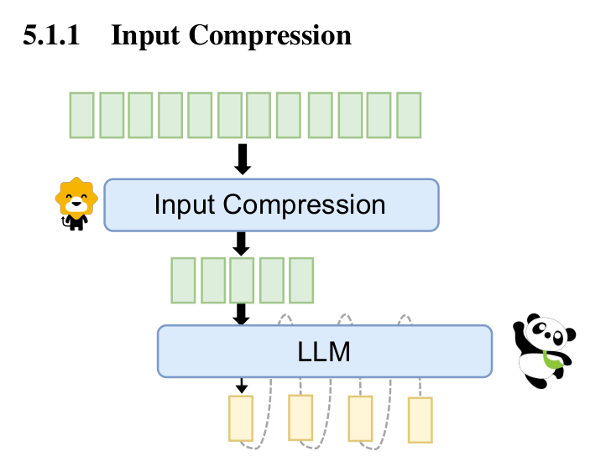
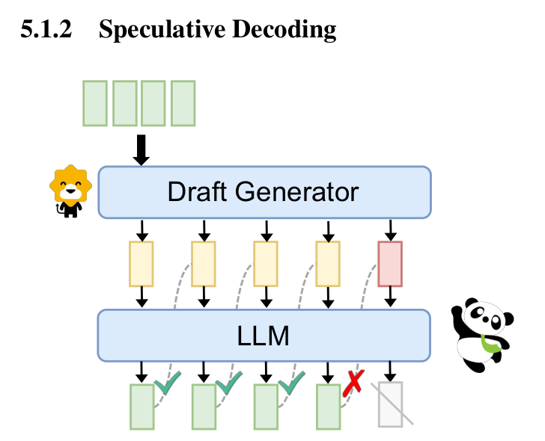
13

Slide 14
14
TECHNIQUES FOR COLLABORATION
2.Knowledge Transfer:
Mitigating Incorrect Knowledge: Contrastive Decoding (CD) help reduce hallucinations by comparing outputs from larger models with those from smaller, less accurate models.
Strengthening Correct Knowledge: Additional models verify outputs to enhance the faithfulness of generated content, ensuring alignment with input attributes.
Supplying New Knowledge: Modifying output logits of larger models based on capabilities extracted from smaller models to enhance performance.
3.Compensatory Cooperation:
Detectors: Additional models detect factual and faithfulness hallucinations, ensuring the reliability of generated content.
Retrievers: Use external data sources to augment LLM knowledge, improving the accuracy of generated responses.

Slide 15
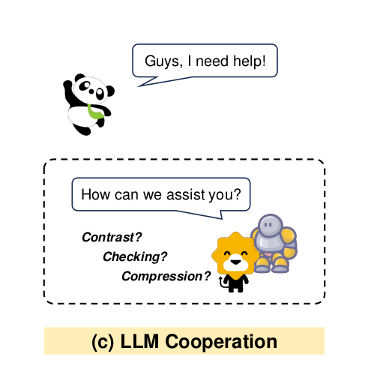
15
TECHNIQUES FOR COLLABORATION
4.Federated Cooperation:
Federated Training: Allows knowledge transfer between large and small models while preserving privacy, enhancing the training data for both.
Federated Prompt Engineering: Local small models convert user instructions into general commands for large models, protecting user privacy while executing tasks.(Cloud based)

Slide 16
16
RESULT
Key Findings :
Performance Improvements : Collaborative models, which utilize strategies like merging and ensembling, demonstrated significant enhancements in performance metrics compared to individual models. This indicates that leveraging multiple models can effectively mitigate the limitations of single models, such as overfitting and lack of robustness.
Effectiveness of Collaboration : Specific algorithms that employ collaborative strategies, such as weighted averaging and ensemble methods, outperformed traditional machine learning approaches. This highlights the potential of collaborative techniques to harness the strengths of various models, leading to superior outcomes.
Validation of Collaborative Strategies : The empirical results presented in the paper validate the effectiveness of collaborative strategies in enhancing model performance. This includes quantitative metrics such as F1 scores, accuracy, and BERTScore, which demonstrate the tangible benefits of collaboration.

Slide 17
17
RESULT
Comparison with Existing Works
Key Points of Comparison :
1.Traditional Approaches:
Existing methodologies often rely on single model training or basic ensemble techniques that do not fully leverage the potential of collaboration among models.
These traditional models may be limited in their ability to generalize across different tasks or datasets, leading to suboptimal performance in diverse applications.
2.Advantages of Proposed Collaborative Strategies:
Enhanced Accuracy: Collaborative models, which combine the strengths of multiple models, consistently outperform traditional approaches in terms of accuracy. This is particularly evident in complex tasks where no single model excels.
Improved Adaptability: The proposed methods demonstrate a greater ability to adapt to varying contexts and requirements. Collaborative strategies allow models to learn from each other, share knowledge, and adjust to new challenges more effectively than traditional models.

Slide 18
18
OPINION
STRENGTHS
Comprehensive Review:
The paper provides a thorough overview of collaborative strategies in the context of large language models, highlighting their significance and potential in enhancing model performance.
Empirical Validation:
The inclusion of empirical results demonstrates the effectiveness of the proposed collaborative strategies, providing a solid foundation for future research.
Identification of Gaps:
The paper identifies key gaps in existing literature, paving the way for further exploration and development of collaborative techniques in natural language processing.
Practical Implications:
The findings have practical implications for researchers and practitioners, offering insights into how collaborative strategies can be implemented to improve model performance in real-world applications.

Slide 19
19
OPINION
Improvements (Weaknesses and Ideas)
Weakness: Limited exploration of real-world applications and scenarios.
Idea: Conduct case studies or pilot projects to test collaborative strategies in various domains, providing practical insights and validation.
Weakness: Focus on traditional methods without exploring cutting-edge techniques.
Idea: Integrate advanced methodologies, such as neural architecture search or transfer learning, to enhance the collaborative framework.
Weakness: Lack of robust evaluation metrics.
Idea: Develop a multi-faceted evaluation framework that includes metrics for robustness, interpretability, and ethical considerations.

Slide 20
Thank You
For your attention

